Slide 1
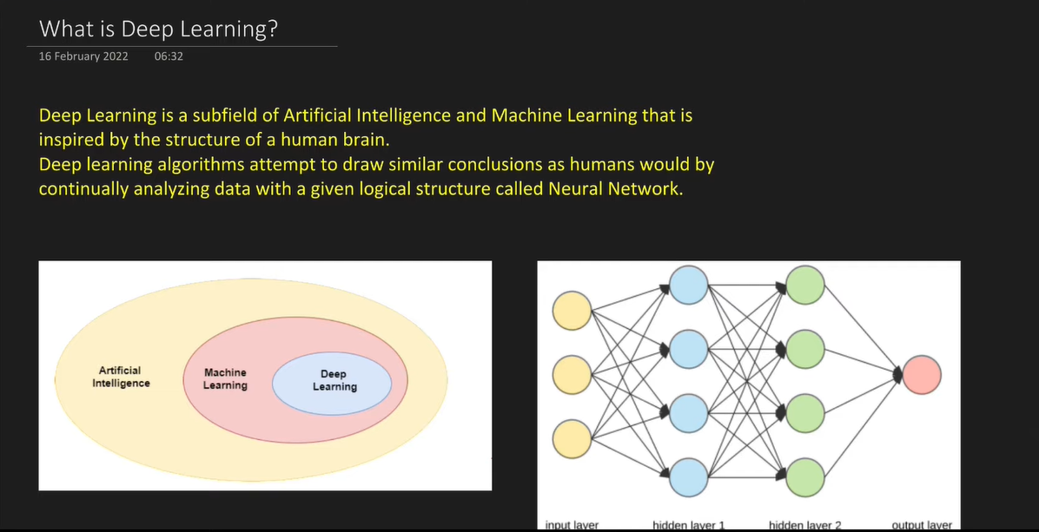

Slide 2
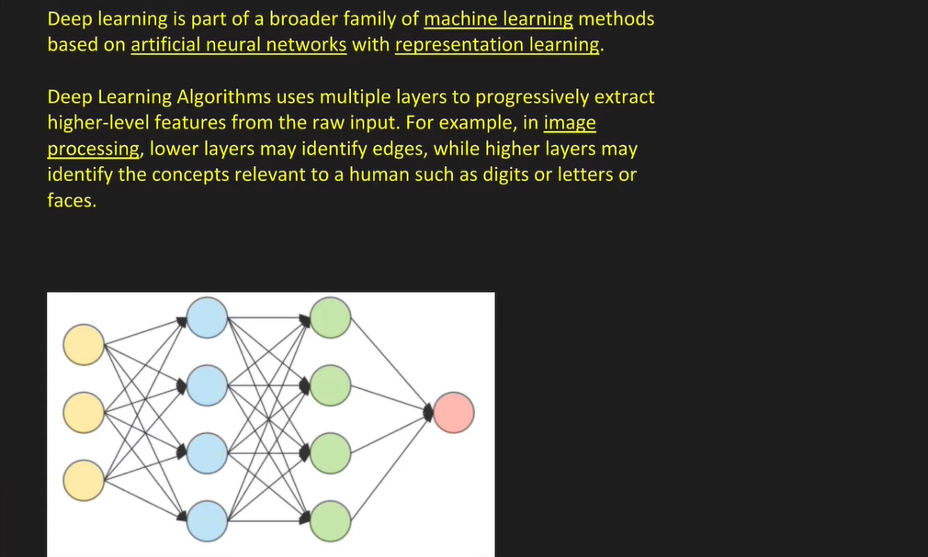

Slide 3
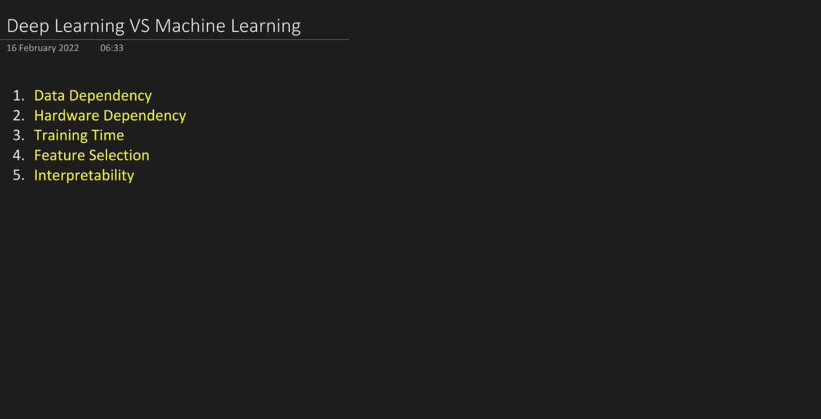
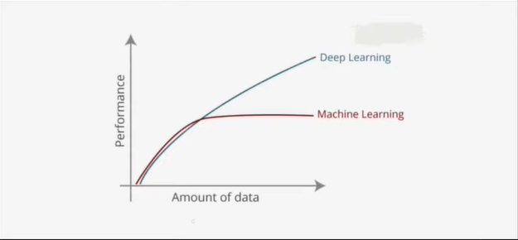

Slide 4
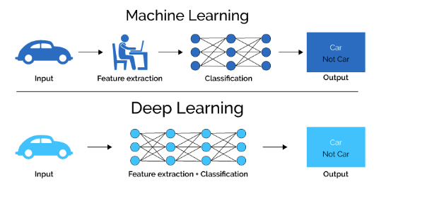
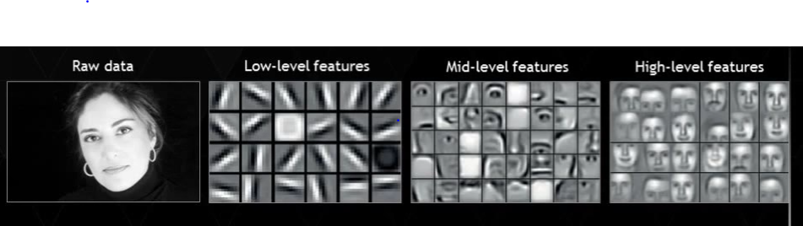

Slide 5
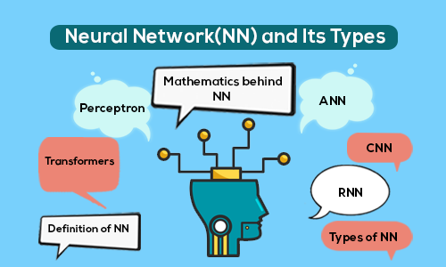

Slide 6
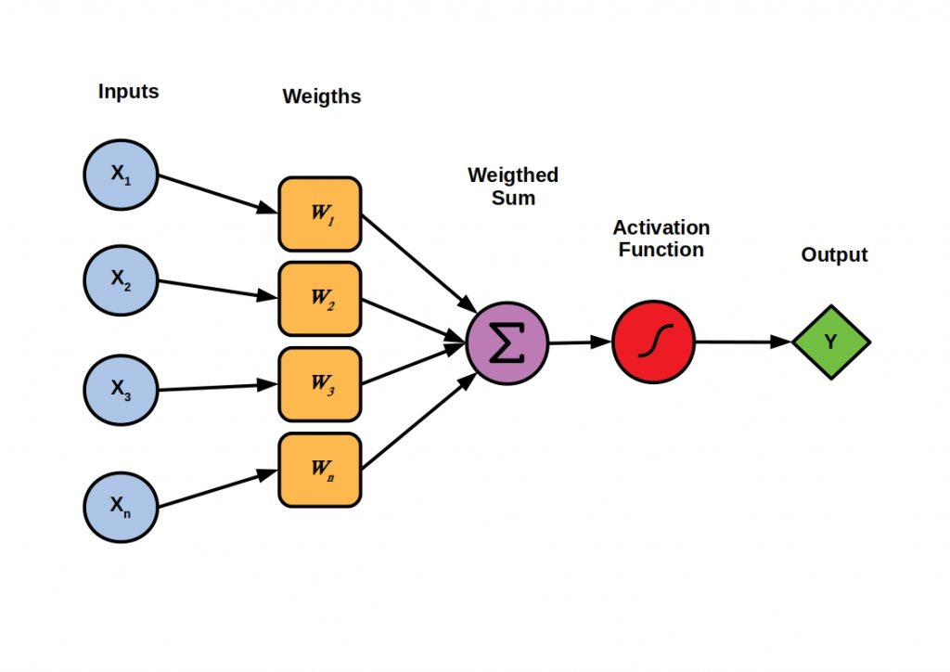
Perceptron
A Perceptron is an algorithm for supervised learning of binary classifiers, it can be used for regression as well. This algorithm enables neurons to learn and processes elements in the training set one at a time.

Slide 7
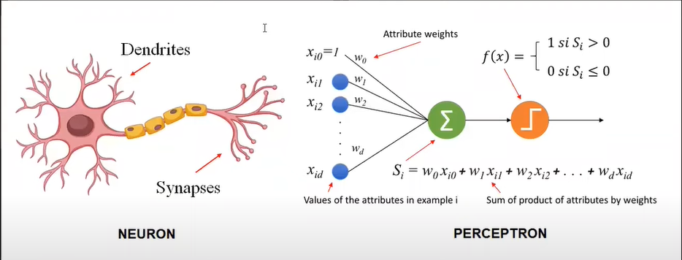

Slide 8
Perceptron Code Demo

Slide 9
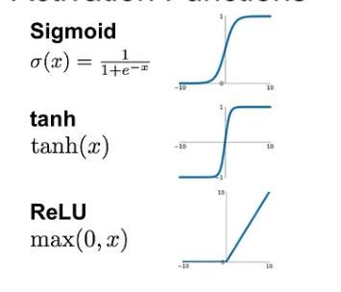
Activation Functions
Activation functions are those computational units which decide what output the neuron must give under a specific condition
In Machine learning and in deep learning we have different types of activation functions which are used to trigger a neuron while building models.
We can also say that a neuron is a cell than activation function is the nucleus of the cell.

Slide 10
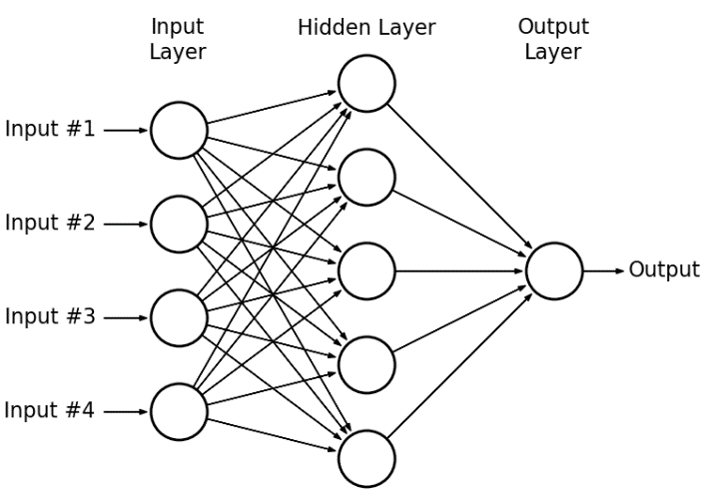
Multi Layer Perceptron

Slide 11
MLP Code Demo

Slide 12
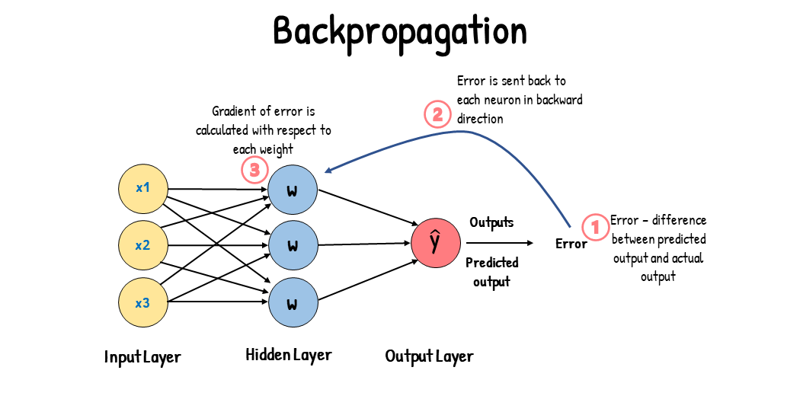

Slide 13
Backpropagation Steps:
Initialize weight and biases (random or w=1 and b=0)
Prediction (Forward propagation)
Calculate error using loss function
Weights and Biases update (Gradient Descent)

Slide 14
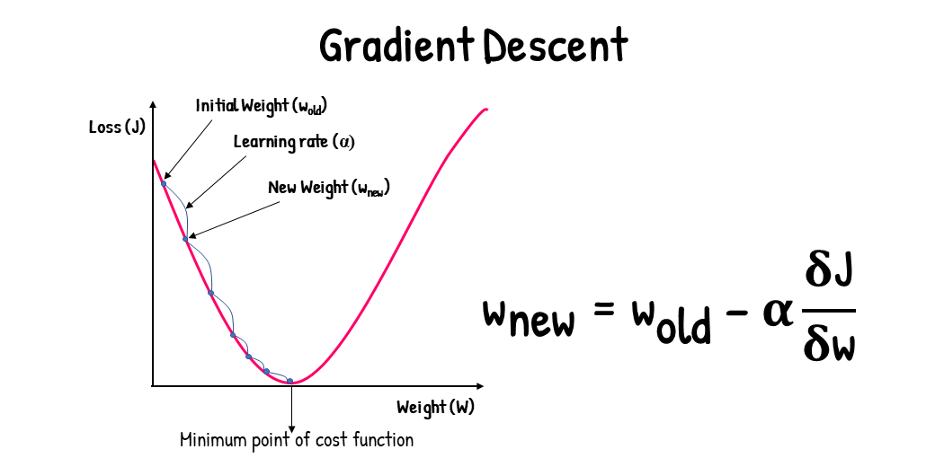

Slide 15
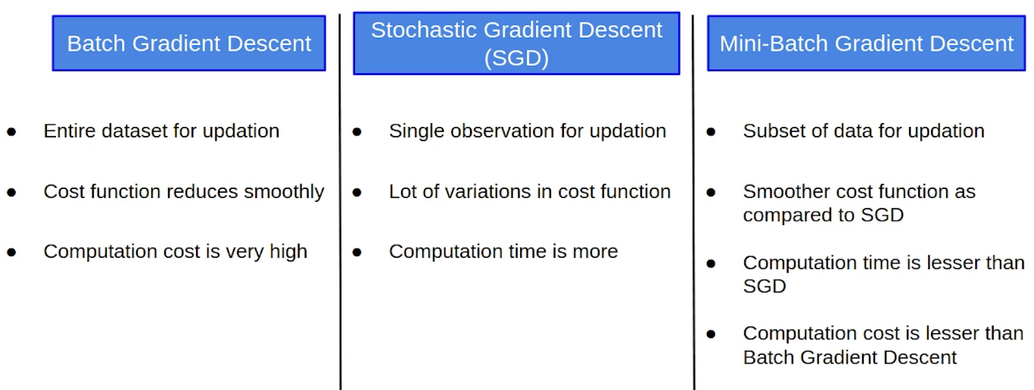
Types of Gradient Descent

Slide 16
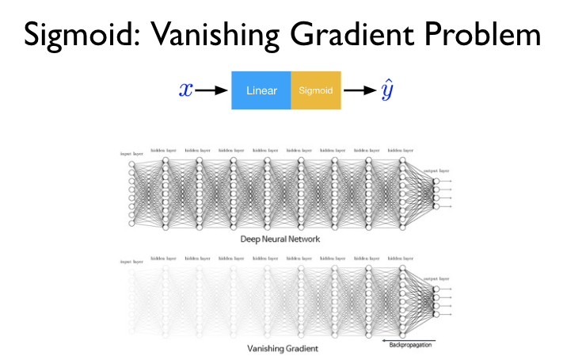

Slide 17
Steps to Handle Vanishing Gradient:
Reduce model depth(complexity).
Use ReLU as activation function instead of sigmoid and Tanh.
Proper weight initialization.
Batch Normalization.

Slide 18
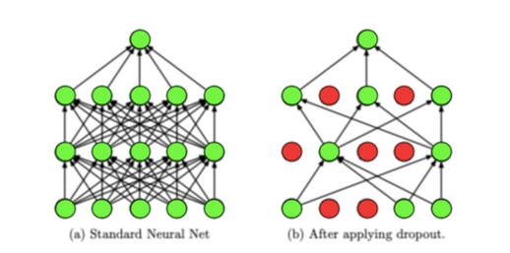
Dropout Layers

